Slide 1

Multiplication; Division
Computer Organization and Architecture | Computer Arithmetic
Course: Computer Organization and Architecture | Chapter: Computer Arithmetic | Bachelor of Engineering
DISCOVER · LEARN · EMPOWER
Notes:
Welcome everyone to today's lecture on Computer Arithmetic. We will focus specifically on the fundamental operations of multiplication and division. These are critical for the performance of any processor. Remember, our motto is Discover. Learn. Empower.

Slide 2
Course Outcomes
SLIDE 2 / 10
Course Outcome
CO | BT LEVEL | DESCRIPTION
CO1 | BT3 | Apply number systems and digital logic to design basic digital circuits
CO2 | BT4 | Analyze register organization and instruction set architecture
CO3 | BT3 | Implement computer arithmetic algorithms and floating-point operations
CO4 | BT5 | Analyze memory hierarchy and input-output organization
CO5 | BT6 | Evaluate control unit design and pipelining performance
Chandigarh University
2 / 10
Notes:
This lecture directly addresses Course Outcome 3. You will learn to implement the algorithms for multiplication and division. These skills are essential for designing efficient arithmetic units. We will focus on how these operations are executed in hardware.

Slide 3
Learning Objectives
SLIDE 3 / 10
Learning Outcomes
1
Analyze the basic restoring division algorithm for signed numbers
2
Evaluate the efficiency of non-restoring division compared to restoring
3
Apply Booth's algorithm to handle signed binary multiplication efficiently
4
Differentiate between hardware implementations of multiplication and division
5
Calculate the number of clock cycles required for division operations
Chandigarh University
3 / 10
Notes:
By the end of this session, you will be able to analyze and evaluate different algorithms. We will apply Booth's algorithm to handle signed numbers efficiently. You will also differentiate between various hardware implementations. Finally, you will calculate the clock cycles required for these operations.

Slide 4
Lecture
SLIDE 4 / 10
Basic Multiplication Algorithm
1
Multiplication involves shifting the multiplicand and adding to the product
2
The algorithm processes one bit of the multiplier per cycle
3
Partial products are generated by ANDing the multiplicand with multiplier bits
4
The final product is the sum of all shifted partial products
5
Hardware requires an adder, a shift register, and a control unit
Chandigarh University
4 / 10
Notes:
Think of binary multiplication as repeated addition and shifting. For example, multiplying 5 by 3 involves adding 5 three ×. In hardware, we shift the multiplicand left and add if the multiplier bit is 1. This process repeats for every bit in the multiplier.

Slide 5
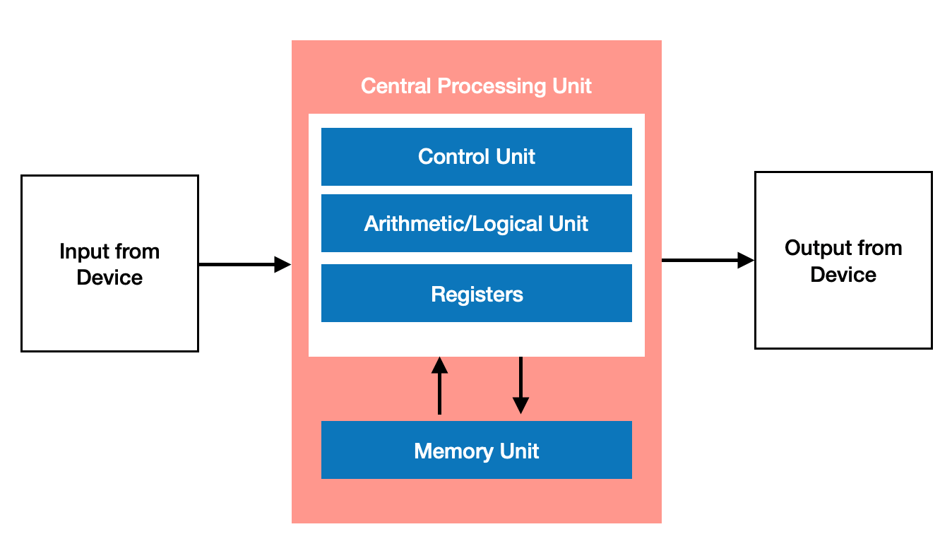
Lecture
SLIDE 5 / 10
Restoring Division Algorithm
1
The algorithm attempts to subtract the divisor from the remainder
2
If the result is negative, the divisor is added back (restored)
3
A quotient bit of 0 is set if restoration is required
4
A quotient bit of 1 is set if the subtraction is successful
5
The process repeats for each bit of the dividend
Understanding Computer Arithmetic — How Your CPU Does Math | by Sayeed Ahmad | Introduction to Computer Organization Sem2 2024/2025 | Mediu
Chandigarh University
5 / 10
Notes:
Restoring division is the most intuitive method but can be slow. If the subtraction makes the remainder negative, we must add the divisor back to restore it. This extra step adds overhead. For example, if we subtract 5 from 3, we get -2, so we add 5 back to get 3.

Slide 6
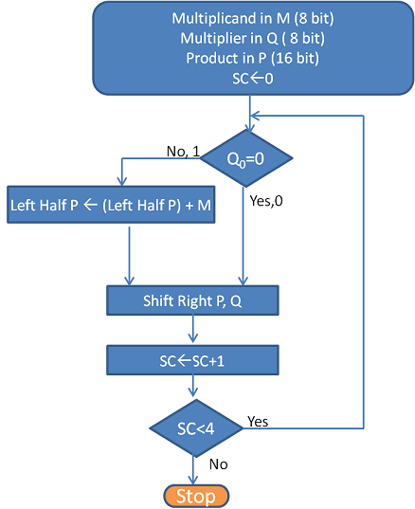
Lecture
SLIDE 6 / 10
Non-Restoring Division
1
This method avoids the explicit restore step to save time
2
If the remainder is negative, we add the divisor in the next step
3
If the remainder is positive, we subtract the divisor in the next step
4
The final quotient may need correction if the remainder is negative
5
It is generally faster than restoring division for hardware implementation
Fixed Point Arithmetic : Multiplication | Computer Architecture (source: res.cloudinary.com)
Chandigarh University
6 / 10
Notes:
Non-restoring division improves speed by skipping the restore step. Instead, we simply add or subtract the divisor based on the sign of the current remainder. For instance, if the remainder is negative, we add the divisor in the next iteration. This reduces the total number of operations required.

Slide 7
Lecture
SLIDE 7 / 10
Booth's Multiplication Algorithm
1
Booth's algorithm efficiently handles signed binary numbers in two's complement
2
It examines pairs of bits to determine if addition, subtraction, or shifting is needed
3
It reduces the number of partial products for sequences of 1s
4
The algorithm looks at the current bit and the previous bit
5
It is widely used in modern processors for signed multiplication
Fixed Point Arithmetic : Multiplication | Computer Architecture (source: res.cloudinary.com)
Chandigarh University
7 / 10
Notes:
Booth's algorithm is a clever way to handle signed numbers. It looks at pairs of bits to decide whether to add, subtract, or just shift. For example, a sequence of 1s like 011110 can be treated as a single subtraction and an addition. This reduces the number of operations significantly.

Slide 8
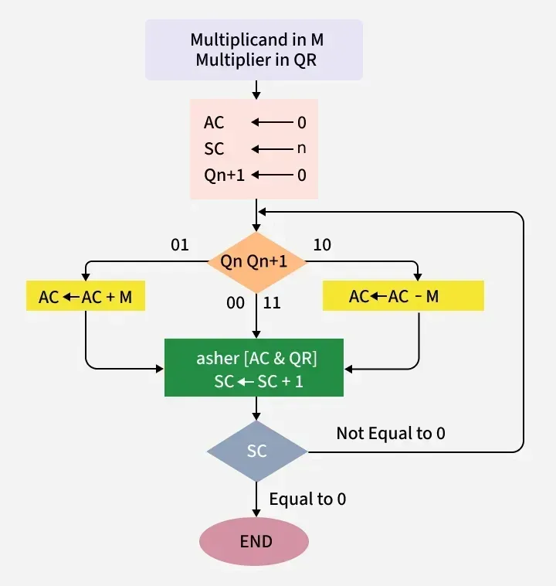
Worked Example
SLIDE 8 / 10
Booth's Algorithm
STEP 1
10 -> Subtract; Step 2: 01 -> Add; Step 3: 10 -> Subtract
• Multiply -3 by 5 using 4-bit two's complement representation
• Multiplicand (-3) is 1101 and Multiplier (5) is 0101
• Append a 0 to the multiplier: 01010
• Final product is -15, which is 11110001 in 8-bit two's complement
Source: media.geeksforgeeks.org
Chandigarh University
8 / 10
Notes:
Let's work through an example. We multiply -3 by 5. We represent -3 as 1101 and 5 as 0101. We append a 0 to the multiplier to get 01010. We then process pairs of bits: 10 means subtract, 01 means add. The final result is -15, represented as 11110001.

Slide 9
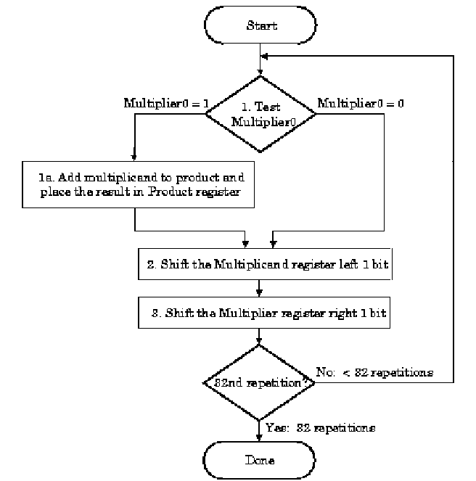
Lecture
SLIDE 9 / 10
Key Takeaways
1
Multiplication uses shift-and-add operations to generate partial products
2
Restoring division requires an extra step to correct negative remainders
3
Non-restoring division is faster by avoiding the restore step
4
Booth's algorithm optimizes signed multiplication by reducing partial products
5
Understanding these algorithms is key to CO3 implementation goals
Source: www.cise.ufl.edu
Chandigarh University
9 / 10
Notes:
To summarize, multiplication relies on shifting and adding. Restoring division is simple but slower due to the restore step. Non-restoring division is faster by skipping that step. Booth's algorithm is the best choice for signed numbers. These concepts are essential for meeting our course outcomes.

Slide 10
Lecture
SLIDE 10 / 10
References
COMPUTER ORGANIZATION AND DESIGN
The Hardware/Software Interface — David A. Patterson, John L. Hennessy
COMPUTER ARCHITECTURE
A Quantitative Approach — John L. Hennessy, David A. Patterson
• Computer Organization and Architecture — William Stallings
• Computer System Architecture — M. Morris Mano & Rajib Mall
• Computer Organization — Carl Hamacher, Zvonko Vranesic, Safwat Zaky
Chandigarh University
10 / 10
Notes:
These five books are the primary resources for this course. They provide detailed explanations of the algorithms we discussed today. I encourage you to read the chapters on arithmetic for deeper understanding. These texts are essential for your future studies in computer architecture.

